Slide 1
Percentage

Slide 2
Concept to discuss
Conversion of percentage to fraction and vice versa
X % of Y = Y% of X
Percentage change
Percentage Increase and decrease concept
Successive increase and decrease
Consumption and Expenditure
Examination , election and population

Slide 3
Percentage: Per means divided and cent means 100.
To convert any value on the base of hundred.
Conversion of percentage to fraction: To convert percentage to fraction, divide that percent value by 100.
E.G. 50% = 50/100 = ½
25% = 25/100 = ¼
Conversion of fraction to percentage: To convert fraction to percentage multiply the fraction by 100.
For e.g. 3/8 = (3/8)*100 = 37.5 %

Slide 4
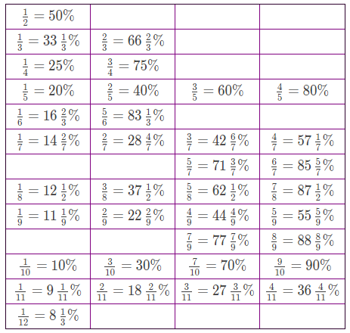

Slide 5
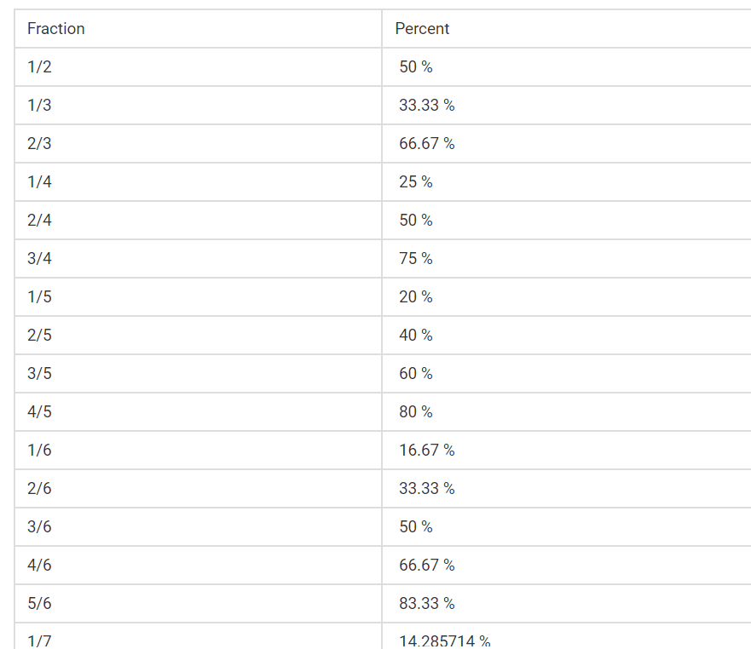

Slide 6
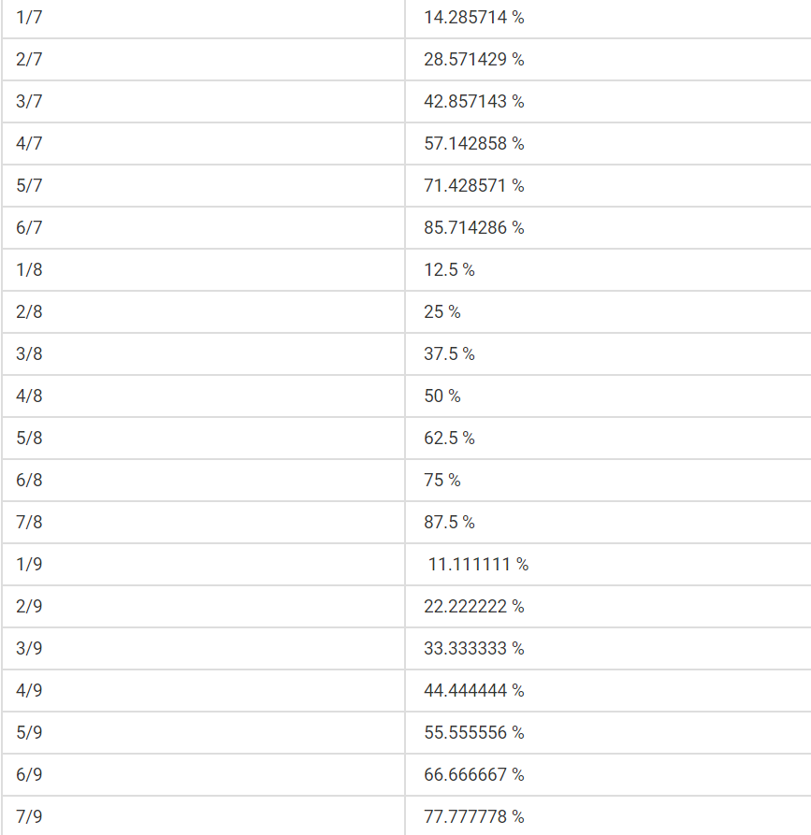

Slide 7
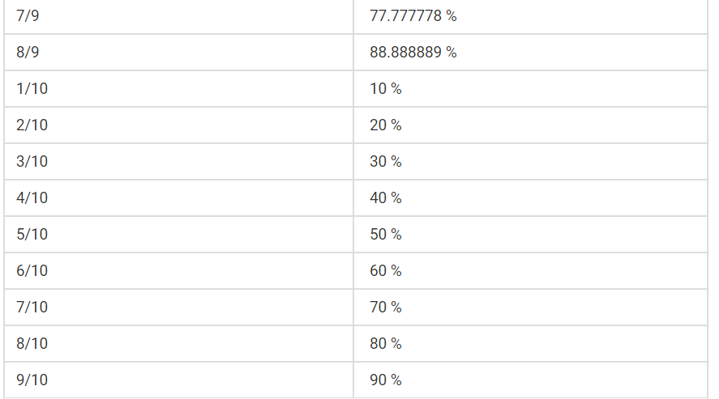

Slide 8
Question : Find 55.55 % of 45.
Question : Find 45.45 % of 44

Slide 9
X % of Y = Y% of X
Question : Find 45% of 133.33
Answer : 45% of 133.33 = 133.33 % of 45
= (100+33.33)% of 45
= (1+1/3) * 45
= 4/3 * 45
= 60

Slide 10
Percentage Change
40 is what percent of 60?
60 is how much percent greater than 40?
40 is how much percent lesser than 60?

Slide 11
Question : If A’s salary is 20 % more than B, then by how much Percent B’s salary is less than A.
20%
25%
16.66%
30%

Slide 12
Question : If A’s marks in an exam is 40 % less than B then by how much % B’s marks are more than A.
40 %
60 %
66.66 %
20 %

Slide 13
Question : If 16(2/3) % of a number is added to itself the number becomes 700. Find original number.
400
600
800
700

Slide 14
Question: A student multiplied a number by 3/5 instead of 5/3 What is the percentage error in the calculation? (a) 44% (b) 64% (c) 40% (d) 60%

Slide 15
Question: The number was being multiplied by 5/6. By mistake it is divided by 5/6. Find percentage error in result. (a) 44% (b) 64% (c) 40% (d) 60%

Slide 16
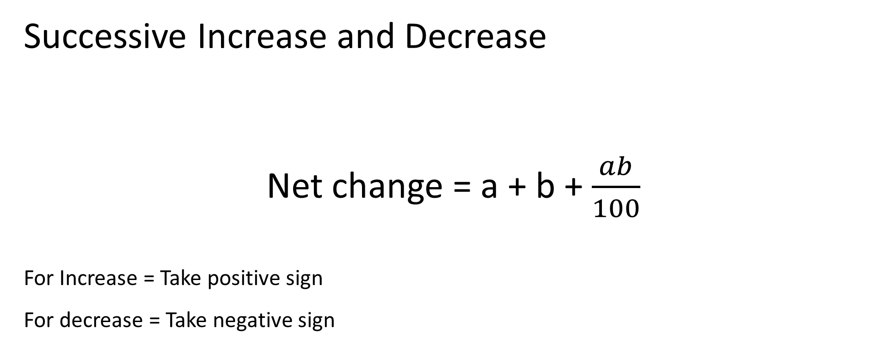

Slide 17
Question : Price of petrol first increased by 20% and then it is decreased by 10% . Find the net change in the price.
8 % increase
2 % decrease
10 % increase
8 % decrease

Slide 18
Question : Demand of a car went down by 25 % in 2016 and 20 % in 2017. What is net % decrease in demand?
45 %
40 %
50 %
60 %

Slide 19
Question : If the length of a rectangle is increased by 20 % and width is decreased by 30% then find the resultant change in area.
16 %
20 %
24 %
28 %

Slide 20
Question : A number is first increased by 15% and then decreased by 20%. The number so obtained is 64 less than the original number. What is the original number?
600
750
800
860

Slide 21
Question :If the price of petrol is raised by 20% then the percentage by which a car owner must reduce his consumption so that there is no change in expenditure.
16.66 %
18 %
15 %
25 %

Slide 22
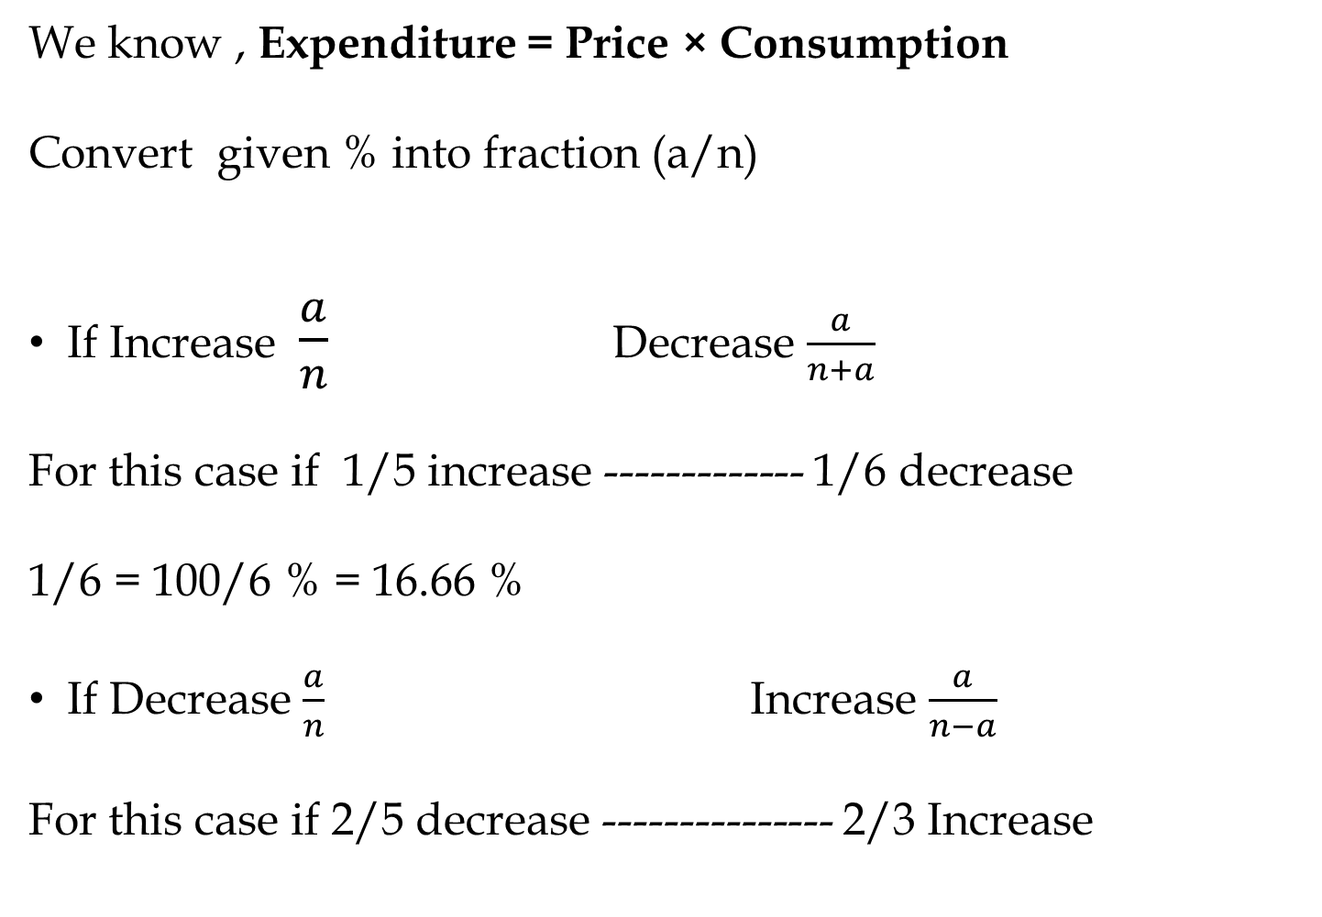
We know , Expenditure = Price × Consumption
Convert given % into fraction (a/n)
If Increase $\frac{a}{n}$ Decrease $\frac{a}{n+a}$
For this case if 1/5 increase ------------- 1/6 decrease
1/6 = 100/6 % = 16.66 %
If Decrease $\frac{a}{n}$ Increase $\frac{a}{n−a}$
For this case if 2/5 decrease --------------- 2/3 Increase

Slide 23
Question :If the price of sugar is decreased by 12.5% then the percentage by which one household must increase his consumption so that there is no change in expenditure.
10 %
8 %
14.28 %
12.5 %

Slide 24
Question :If the price of commodity is decreased by 20% and its consumption increased by 20%, what will be the change in expenditure.
4 % increase
4 % decrease
8 % decrease
8 % increase

Slide 25
Question: If the price of sugar is increased by 25% then by how much percent consumption should be reduced so that the expenditure will increase by only 5%
(a) 25%
(b) 15%
(c) 16%
(d) 20%

Slide 26
Question :If the price of sugar is reduced by 20% due to which a person can buy 2kg more sugar for Rs. 200. Find the original price of sugar per kg.
Rs. 25 per Kg
Rs. 20 per Kg
Rs. 22 per Kg
Rs. 16 per Kg

Slide 27
Question: The price of sugar is increased by 30% due to this a housewife purchase 12 kg less sugar so that her expenditure will increase by 10% only. Find her original consumption.
(a) 70 kg
(b) 80 kg
(c) 75 kg
(d) 78 kg

Slide 28
Question : A student scored 140 Marks and still failed by 35 marks. If the passing criteria of that exam is 35%. Then find the maximum marks of that exam.
500
600
1000
700

Slide 29
Question : A student scored 25 % in an examination and still failed by 30 marks while another candidate scored 50% marks and get 20 marks more than the passing marks. Then find the passing percentage.
30 %
40 %
45 %
50 %

Slide 30
Question : A student scored 30 % in an examination and still failed by 12 marks while another candidate scored 40% marks and got 28 marks more than the passing marks. Then find the maximum marks in the examination.
300
400
500
700

Slide 31
Question: In an Exam, 52% candidates failed in English, 42% in mathematics and 17% in both. What was the number of percentage of passed students in both subjects?
(a) 23
(b) 77
(c) 6
(d) 94

Slide 32
Question: In an Exam, 70% candidates passed in English, 65% in mathematics and 27% failed in both. If 248 candidates was pass in both the subjects, then What was the total number of students?
(a) 300
(b) 400
(c) 500
(d) 600

Slide 33
Question : The population of a town is 50,000. It increases by 10% in the first year and 12% in the second year. What will be the population after 2 years.
55000
61600
72700
84600

Slide 34
Question : The current population of a town is 28,000.During the last 2 years the population increased at the rate of 16% and 20% per year. The population 2 years ago was (approximately)
24000
22000
20000
18000

Slide 35
Question : Raju invest 65% of his investment in a machine and 20% of his investment on raw material. If he has Rs. 6000 balance. Find the total money he had.
30000
40000
50000
60000

Slide 36
Question : Raju spend 40% of his salary on house rent. On the remaining 10% spend on travel. On remaining 16(2/3) % spend on food and remaining is saved . Find the money he spent on food.
Rs. 450
Rs. 400
Rs. 500
Rs. 600

Slide 37
Question: In a library 20% of the books are in Hindi, 50% of the remaining in English and 30% of the remaining are in French and rest 6300 books are in regional language. Then find the number of books in library.
(a) 20000
(b) 22500
(c) 35000
(d) 15000

Slide 38
Question: In an Election between two candidates one got 65% of the votes and won by 300 votes. Find total no. of votes.
(a) 1200
(b) 1500
(c) 1800
(d) 1000

Slide 39
Question : In a election of 2 candidate the candidate who gets 40% of the total votes rejected by 80 votes. Find total number of votes.
450
400
500
600

Slide 40
Question : In a election of 2 candidate 12 % of the voters did not cast their votes. The winner by getting 45% of the total votes, defeated his rival by 2000 votes. Find the total number of voters.
25000
50000
80000
100000

Slide 41
Question: In an Election, 10% persons didn't cast their votes and 10% found to be invalid. The winner got 54% of valid votes and won by 1620 votes. Find total number of votes?
(a) 12500
(b) 17500
(c) 25000
(d) 35000

Slide 42
Question: In an election two candidates participated. 20% voters did not cast their votes, out of which 600 votes declared invalid and the winner get 75% of valid votes and wins by 1500 votes. Find the number of total votes.
(a) 3600
(b) 3000
(c) 4000
(d) 4500

Slide 43


